Slide 1




Adiel Dolinsky
The Open University of Israel
B.Sc. Student in Computer Science & Economics
"There is no greater joy than finally cracking the solution to a complex problem that has challenged me for a long time."

Slide 2

RAGBI: Smart Insurance Assistant
The Problem: Purchasing insurance is easy, but understanding it is hard. This leads to unclaimed benefits and unnecessary out-of-pocket expenses.
The Users: Anyone who struggles with complex policy documents and needs clear, accessible health coverage information.
The System: An AI assistant that uses RAG to retrieve policy details instantly and compare coverage across different plans.

Slide 3




Technology Stack
2. AI & Core Engine
1. Application & Infrastructure
AWS Bedrock & Claude & RAG Engine
Flask & Docker
3. Data & MCP/Tools
4. Version Control
AWS Lambda & Pandas
GitHub

Slide 4






System Architecture: Knowledge Base Pipeline
Upload & Parsing
Admin Lambdas
Targeted S3 Storage
Policy PDF Ingestion
Isolated Heavy Processing
Optimized Knowledge Base
(vs. Runtime Agent Lambdas)

Slide 5








System Architecture: Query Routing Pipeline
RAG Route
Text Extraction & Side-by-Side Comparisons
User to Flask
AWS Bedrock Agent
Final Generation
Tools / Action Group Route
Hallucination-Free Answer
Interface Gateway
Central Orchestrator
Math & CSV Operations via Lambda + Pandas

Slide 6
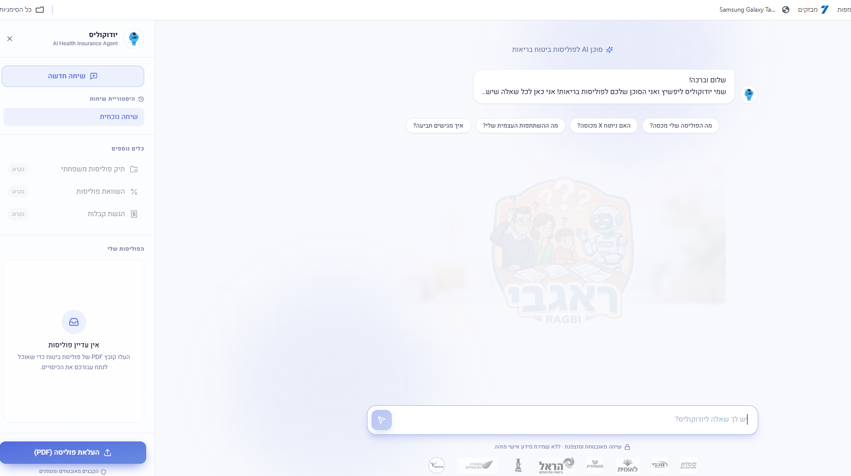

Live Demo: RAGBI Interface
Key Features
Simple policy document upload.
Natural language queries (Q&A).
Side-by-side coverage comparison.
Verified citations from source documents.

Slide 7




Challenges & Future Roadmap
Technical Challenges
Future Roadmap
• Ensuring precise and accurate context retrieval within the RAG engine.
• Enhancing and optimization of RAG generation and responses.
• Structuring and constructing a high-quality dataset (SetData).
• Advancing the architecture to move closer toward an efficient market model.
UNDER CONSTRUCTION

Slide 8

Questions?
Thank you for your attention.
https://github.com/adieldolinsky/insurance-rag-assistant
adiel.dolinsky@email.com

Slide 9



Image Sources
https://www.boisestate.edu/computing/wp-content/uploads/sites/981/2025/07/CareerPhoto_EricMelin-e1744130037322.jpg
Source: www.boisestate.edu
https://www.wonderbaby.org/wp-content/uploads/2025/05/robot-dr-feature.png
Source: www.wonderbaby.org
https://cdn.dribbble.com/userupload/44053404/file/original-95a661187c2fb1f5805242d371cb73d6.png?resize=752x&vertical=center
Source: dribbble.com

